Slide 1
FNF Locator
Richard Downs (@01152245)
S M Azharul Karim (@01519097)

Slide 2
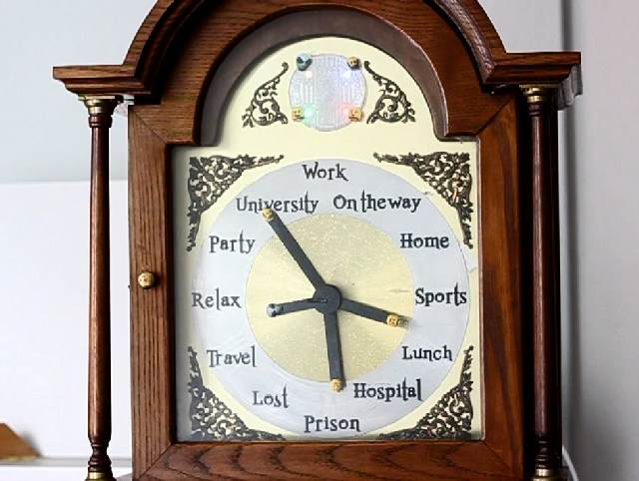
App Structure
Activities
Login
Main Menu
Create Clock
Display Clock
Service
Refresh
Broadcast
Boot
Sensor Listener
Database
2 Local – SQLite
Remote – Amazon Web Services
AWS Mobile Client and Configuration

Slide 3
App Operation
The Username can only be set on Login
The user location is defined in the preferences and updated by interacting with the app
Manual vs Automatic operation
Create custom groups
Display the custom groups
In the background
Updating the remote database as soon as the user changes location
Pulling user location from the remote database at user set intervals

